Slide 1
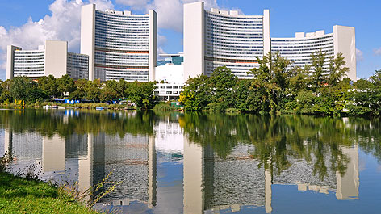
Doing Business with the United Nations
Joseph Khamis
United Nations Office at Vienna
Procurement Unit
October 2020

Slide 2
Outline
UN Secretariat – Area of Operation
UN Procurement Volume and Statistics
UN Procurement Major Commodities
Procurement Volume by Italian Supplier
UNOV Procurement Volume
UN Procurement Principles
Typical UN Procurement Workflow
Vendor Registration and doing Business with the UN
Q&A

Slide 3
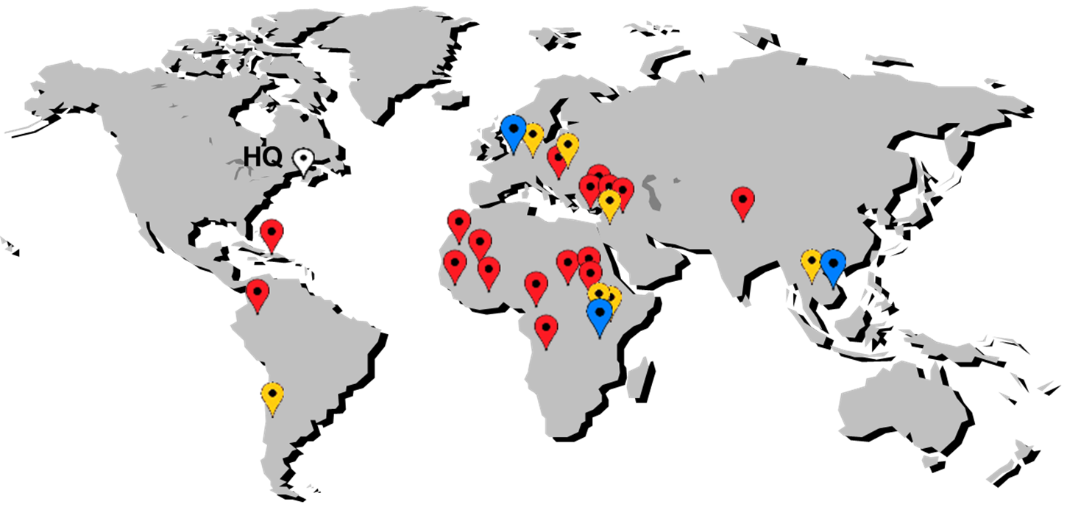


The United Nations Secretariat - Area of Operation

Slide 4
UNPD Procurement Volume 2013 to 2019

Slide 5
UNPD Procurement by Major Commodity 2019

Slide 6
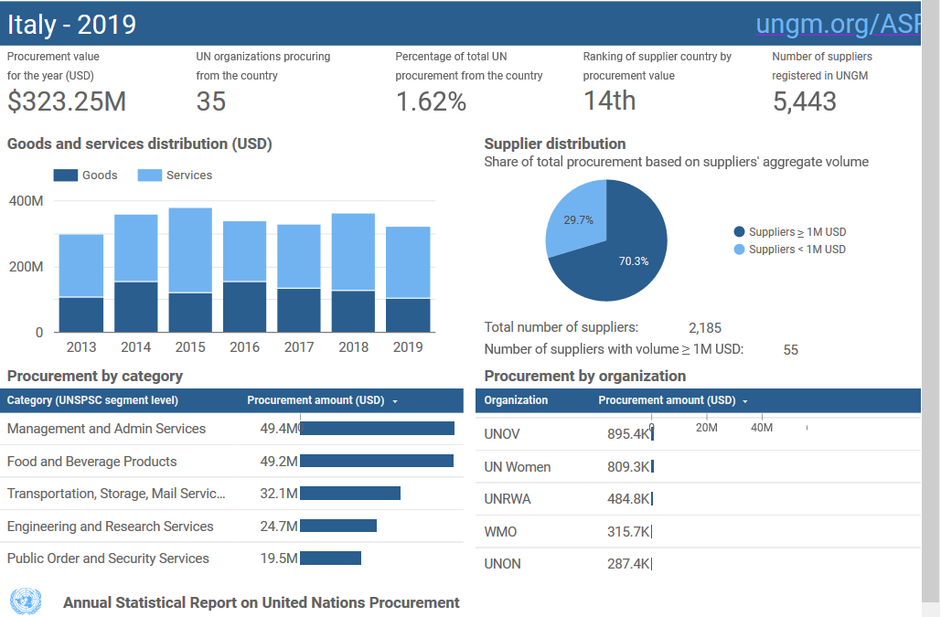
Procurement Volume by Italian Supplier
Ref: https://www.ungm.org/Shared/KnowledgeCenter/Pages/asr_data_country

Slide 7
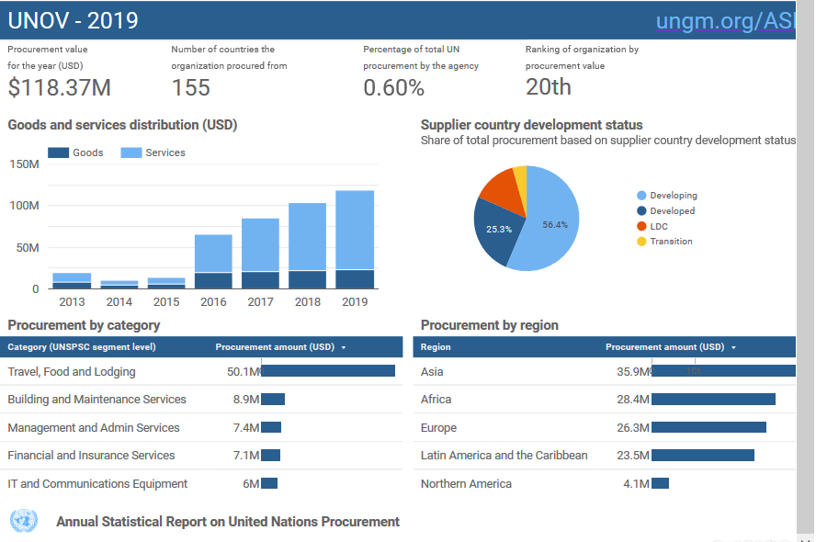
UNOV Procurement Volume
Ref: https://www.ungm.org/Shared/KnowledgeCenter/Pages/asr_data_organization

Slide 8
UN Procurement Principles
Procurement activities of the UN system are based on the following principles:
  The objectives/needs of the UN Organization
  Fairness, integrity & transparency
  Effective international competition
  Best value for money
These principles cover procurement stages from sourcing to execution of a procurement contract.

Slide 9
Typical UN Procurement Workflow
Procurement Planning
Requirement Definition
Market Research/ Advertisement
Selection of Procurement Strategy
Evaluations (Technical and Commercial)
Receipt and Opening of Offers
Bidders Conference / Q&A
Preparation & Issuance of Solicitation Documents
Internal Review / Approval
Contract Award / Regret Letter
Debriefing

Slide 10
Doing Business with the UN System
Registration on the United Nations Global Marketplace
Identify Relevant UN System Organizations and their Requirements
United Nations Procurement Mobile App
Frequently Asked Questions

Slide 11
Registration on the United Nations Global Marketplace (UNGM)
UNGM is the UN global vendor portal.
Registration is mandatory for all Commercial Vendors.
Vendors can introduce their products and services to many UN organizations, countries and regions by only completing one registration form.
UNGM also enables vendors to keep abreast of upcoming tender notices. By subscribing to the Tender Alert Service, vendors can receive relevant business opportunities emailed directly.
https://www.ungm.org

Slide 12
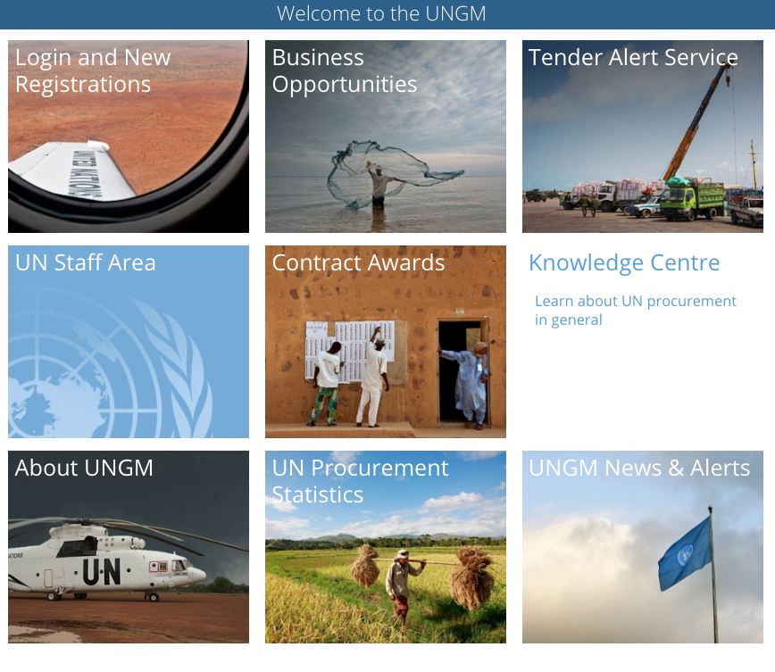
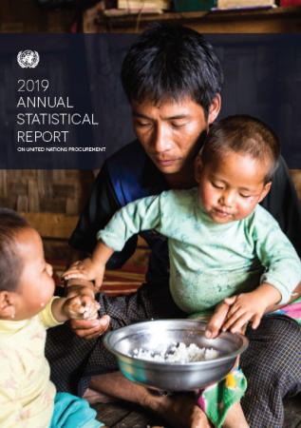
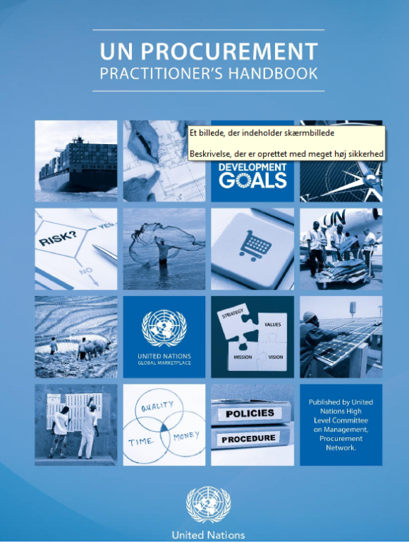
Identify Relevant UN System Organizations and their Requirements
UNGM Knowledge Centre
Annual Statistical Report
UN Procurement Practitioners
Handbook

Slide 13

United Nations Procurement Mobile App
The "UN Procurement" Mobile App offers real-time access to information related to business opportunities, business seminars schedule and contract awards. Features of the Mobile App include:
Event calendar including Business Opportunities, Seminars, Public Tender Openings, and official UNHQ Holidays.
Purchase Orders and Contracts Monthly Awards data that can be filtered by year, month and commodity group.
Procurement Bulletins providing timely updates on a wide range of topics.
Comprehensive search functionality throughout the Application.
Ability to easily share information and add events to your calendar.
Multi-Year Statistical data.
Other Procurement Resources.
Some features are only available for iOS. An update to the Android version is coming soon.

Slide 14
Common Questions
I am a small vendor. Is it worthwhile for me to register when the UN is such a large organization? Do I have an opportunity to do business with the United Nations Secretariat?
We have a new product that we believe the United Nations should know about. Who should we talk to? Could you please give me names of persons from the UN Secretariat who are in charge of “XYZ” products?
Yes, of course. The United Nations procures on an international basis from vendors of all sizes and from all geographical locations. Sometimes our requirements are large and sometimes our requirements are small. For this reason, we have different levels of registration and companies can choose the level at which they wish to register based on the size of their company and the size of contract that they are able to manage. A description of the different levels of registration and the requirements for each level can be found at the UNGM website.
Contact information for UN Secretariat Procurement can be found in the Contact Us section of the UNPD website and on the UNGM website for other Agencies, Funds and Programmes.

Slide 15

THANK YOU!!
ANY QUESTIONS, PLEASE?

